Slide 1

<Book Recommendation and tracker System>
School of Computer Science and Engineering
Department of Computer Science and Engineering
Submitted By:
<Kumar Sambhav Singh Rathore>
<2427030694>
Supervised By:
<Mr. Bhawani Singh Rathore>

Slide 2
Outline
Introduction
Literature Review
Problem Statement
Proposed Solution
Objectives
Results

Slide 3
Introduction
Conventional library systems only concentrate on manual search and catalog management.
They don't offer effective navigation support, transparency, or personalization.
As digital intelligence increases, users anticipate:
Tailored recommendations
Quicker discovery of books
Clear recommendation logic
Shorter time spent physically searching
This project suggests a Smart Library System that combines physical shelf mapping, Explainable AI (XAI) and hybrid recommendation logic.

Slide 4
Literature Review
Several recommendation approaches exist:
content based filtering:
suggests items based on the similarity of attributes such as genre or author.
collaborative filtering:
suggests items based on the preferences of similar users.
hybrid recommendation systems:
combine both techniques to get higher accuracy.
Research also highlights the importance of Explainable AI in increasing trust in recommendation systems. However, most existing systems focus on digital platforms and do not integrate physical location mapping or explainability within library environments.

Slide 5
Problem Statement
Library users face:
Difficulty in discovering relevant books, Lack of personalization, Time-consuming manual shelf search
And on top of that No transparency in digital recommendation systems.
There is a need for an intelligent, explainable, and location-aware recommendation system for physical libraries.

Slide 6
Objectives
Hybrid Book Recommendation System: Implementing the System
Explainable AI: Integrating the System
Reduction in the Average Time Taken for Searching Books in the Physical Library
Improvement in the Accuracy of the Recommendation System Using Similarity-Based Methods
Real-Time Location System for the Books on the Shelves
Hybrid System: A Scalable Approach for the Future

Slide 7
Proposed Methodology
System Overview:
User Interface Layer – Web-based dashboard for interaction
Hybrid Recommendation Engine – Merges the principles of similarity and behavior-based recommendation systems
Explainability Module (XAI) – Generates human-readable explanations
Location Mapping Module – Displays section and shelf details
Database and Analytics Layer – Manages metadata and analytics
These components work in concert to provide accurate, transparent, and efficient recommendations.

Slide 8
Proposed Methodology
Data Collection & Preprocessing:
• Collection of book metadata including title, author, genre, language, keywords, and shelf number
• Recording user activity such as search queries and borrowing history
• Cleaning and standardizing data
• Converting categorical features into numerical vectors
•Preparing structured data for similarity computation
This stage ensures that the system has reliable and consistent data for analysis.

Slide 9
Proposed Methodology
Similarity Computation:
• Application of Cosine Similarity to measure content similarity between books.
• Implementation of K-Nearest Neighbor (KNN) logic to identify closely related books or users.
• Generation of similarity scores.
• Ranking of books based on relevance score.
This forms the technical backbone of the hybrid recommendation engine.

Slide 10
Proposed Methodology
Explainable AI Integration
To avoid black-box behavior:
Generate feature-based explanations
Display similarity reasoning such as:
“Genre match found”
“Author similarity detected”
“Popular among similar readers”
• Provide confidence score for each recommendation
The XAI module enhances transparency and increases user confidence in the system.

Slide 11
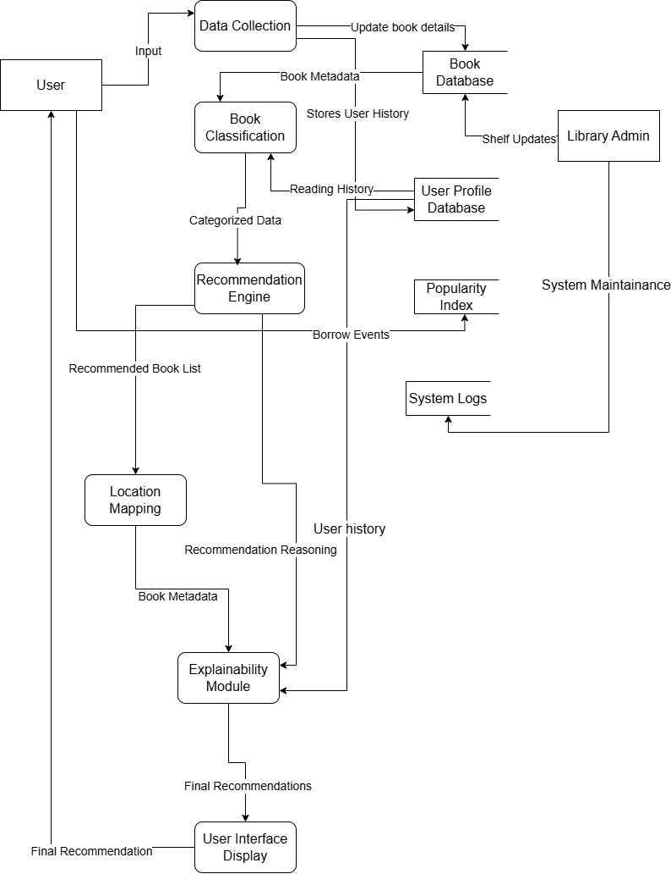
Methodology data flow diagram:

Slide 12
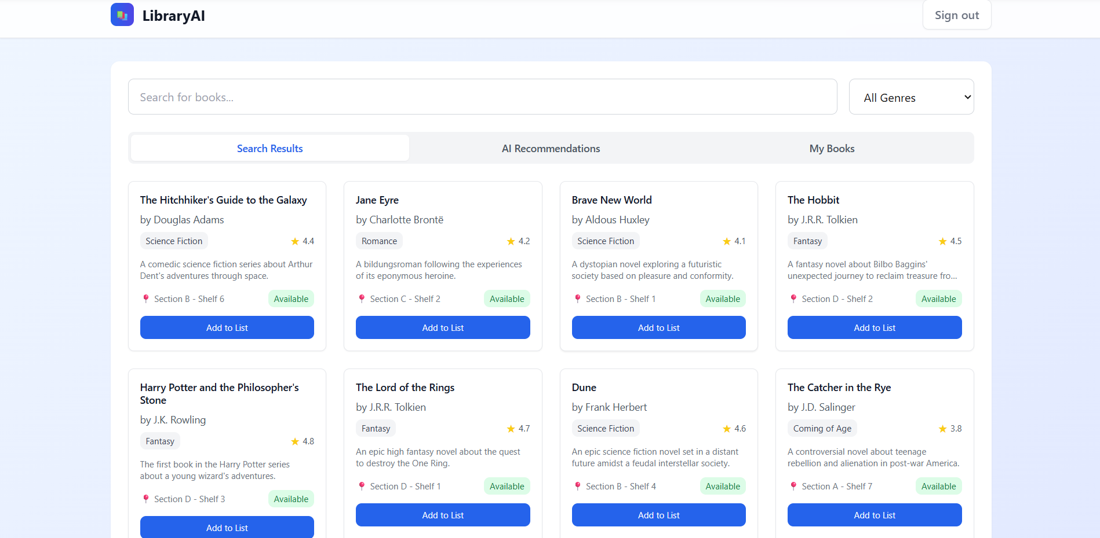

Slide 13
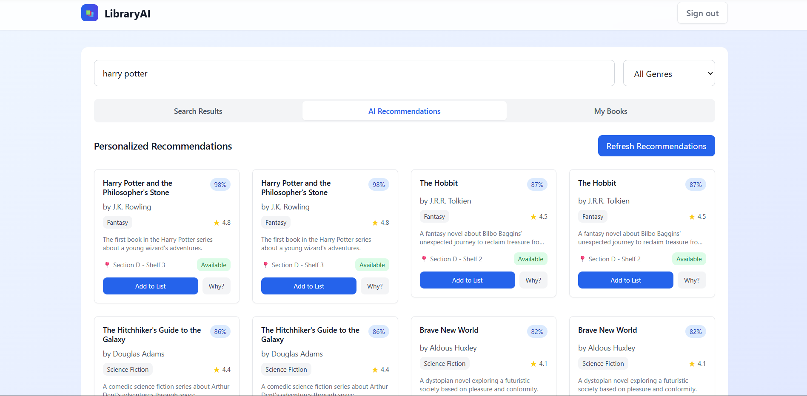

Slide 14
Outcomes
The proposed system enhances traditional libraries by combining intelligent recommendation logic with explainability and physical navigation.
It improves:
• Personalization
• Efficiency
• Transparency
• User engagement
The project successfully bridges the gap between digital recommendation intelligence and physical library navigation.

Slide 15
References
[1] “A Survey on Popularity Bias in Recommender Systems” by Klimashevskaia, Jannach, Elahi, Trattner,
https://www.researchgate.net/publication/381913966_A_survey_on_popularity_bias_in_recommender_systems [2] “Recommendation Systems in Libraries: an Application with Heterogeneous Data
Sources” by Speciale, Vallero, Vassio, Mellia (2023), https://arxiv.org/abs/2303.11746
“Embedding in Recommender Systems: A Survey”,
https://arxiv.org/html/2310.18608v2
“Explainable Recommendation: A Survey and New Perspectives” by Yongfeng Zhang and Xu Chen, https://arxiv.org/abs/1804.11192

Slide 16
Thank You

